Slide 1
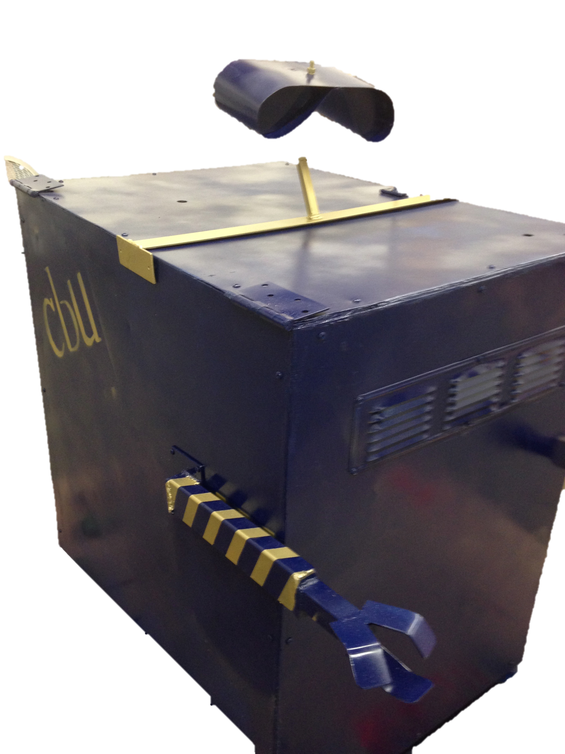
Solar Mobile Power Station
Sneaky Rain
Jordan Rainey
Rocky DeLyon
Jordan Ziegler
Daniel Lombardo
Joshua Hanson

Slide 2
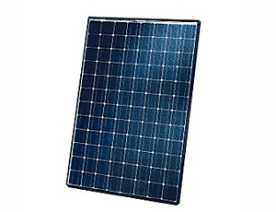
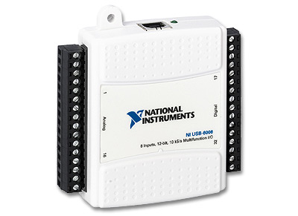
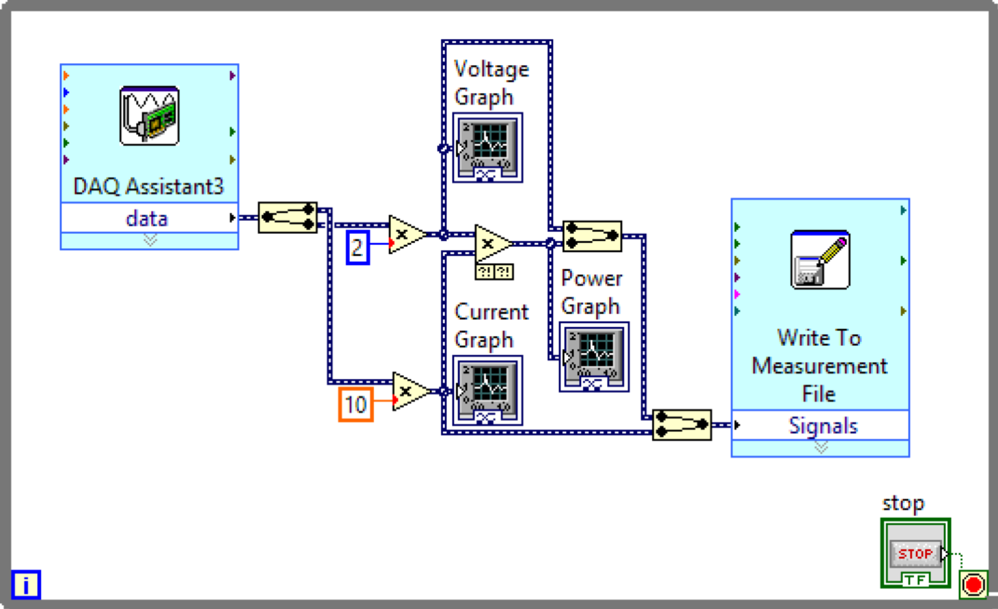
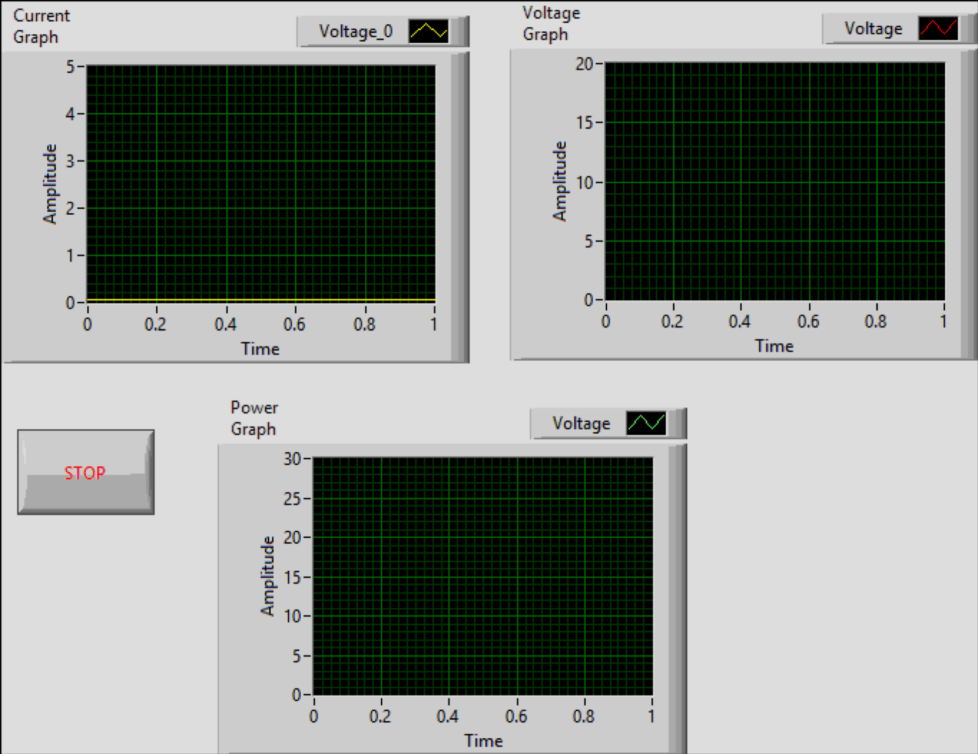
The program is essential in reading data from the solar panel.

